Slide 1
Project data analysis with excel

Slide 2
Agenda
Tables in data model
insights
recommendations

Slide 3
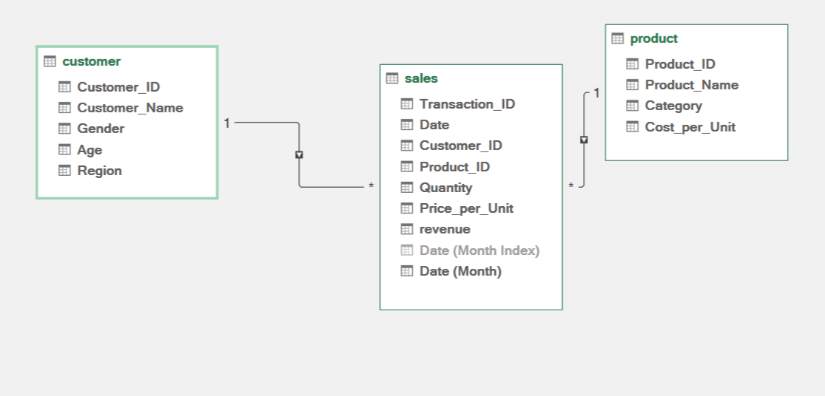
Tables in data model

Slide 4
insights

Slide 5
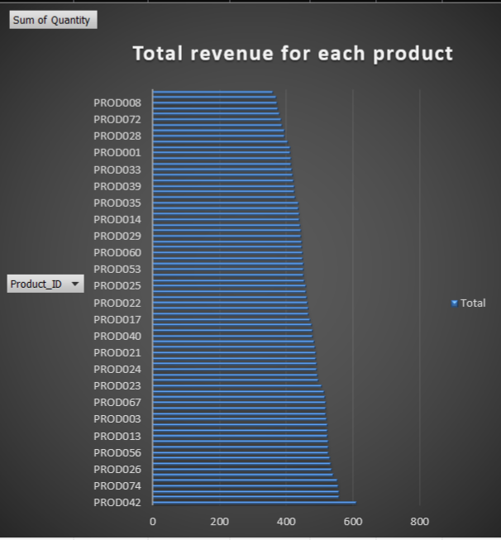
"Focusing on the best-performing products and optimizing the strategy for underperforming ones can significantly improve overall revenue and profitability

Slide 6
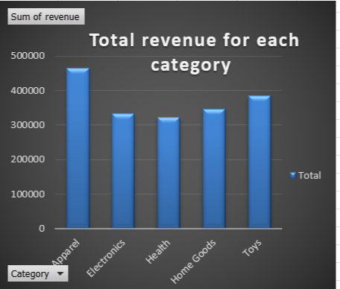
The revenue across different categories is relatively similar, with the Apparel category showing a slightly higher revenue compared to the others.

Slide 7
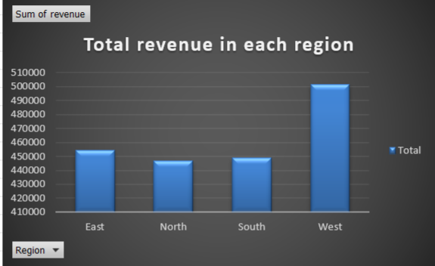
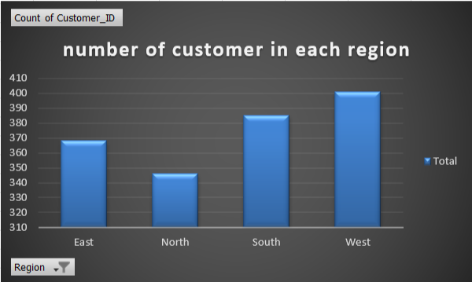
The West region generates the highest revenue because it has the largest number of customers.

Slide 8
Males generate more revenue than females.

Slide 9
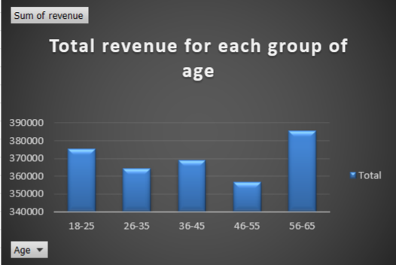
The 56-65 age group generates the highest revenue.
The 46-55 age group has the lowest revenue

Slide 10
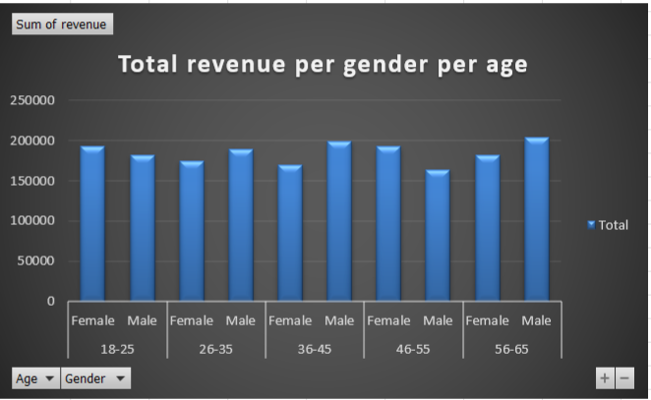
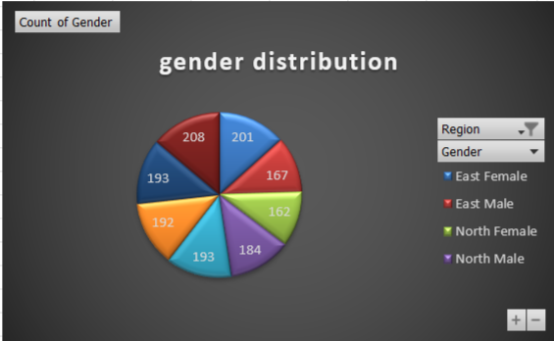
Revenue is fairly balanced between genders in each age group and region but males in the 56-65 age range show a noticeable increase, females in the 18-25 age range also show increase

Slide 11
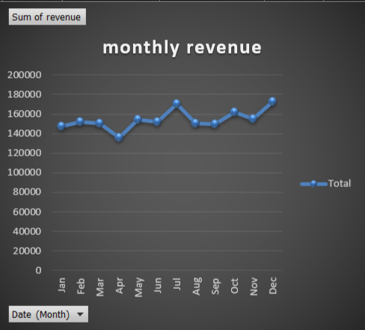
showing that July and December have the highest revenues. April has the lowest monthly revenue.
Revenue tends to rise during mid-year and towards the end of the year.

Slide 12
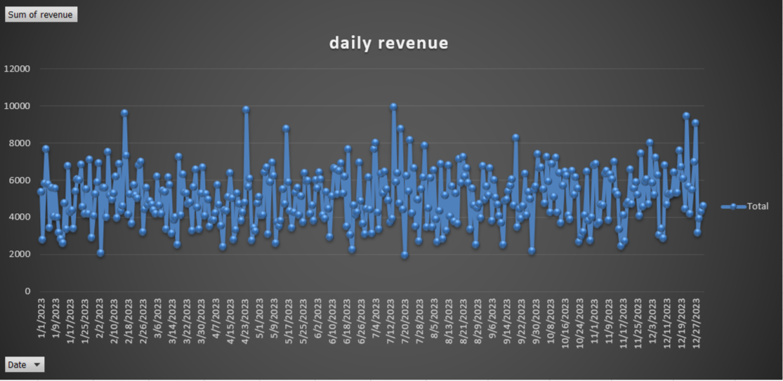
shows fluctuations in daily revenue throughout the year, with multiple peaks and dips.
There are noticeable spikes around mid-February, mid-April, mid-July, and late December.
Some periods show sustained lower revenue, especially during August and September.

Slide 13
recommendations

Slide 14
recommendations
Focus on marketing products to older age groups, particularly males aged 56-65, as they generate the highest revenue.
Enhance presence in the West region due to its outstanding performance.
Support targeted marketing campaigns for females aged 18-25 to further boost revenue in this segment.
Increase the quantity of profitable products and offer discounts on low-performing ones
Increase promotions and stock in July and December
Offer discounts and special deals in April, August, and September

Slide 15
Thank you

